Slide 1
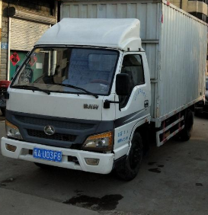
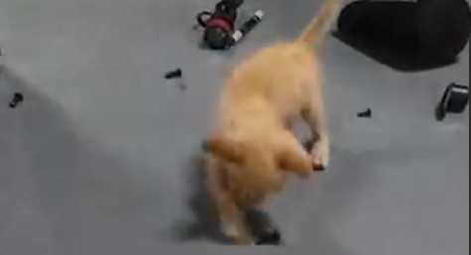
The lost bolt ---十校联盟续写讲评

Slide 2
You'd think that after hearing Mom and Dad talk about The Trip for a year, I'd be eager to go. But I didn't even want to think about it. “Aren't you excited?” asked Dad, looking up from his laptop. “This is the trip of lifetime. I'll bet none of your friends will be driving across the United States this summer.
Exactly, I thought. Nobody I knew was going to pile into an old van, and drive from California to New York and back in 58 days. Fifty-eight days! That was practically my whole summer! But I knew it was useless to protest.
When Dad was offered a summer off for the first time in his career, he said that he'd always dreamed of driving across

Slide 3
the country. So we were going. This was Dad's chance.
I picked up my cat, Max, and buried my face in his fur. He pawed at my ears playfully. Good-bye, summer vacation. Good-bye, diving at the lake. Good-bye to hanging out and doing absolutely nothing. Good-bye, Max. I was going to miss this ball of fur. I put him down and laughed as he batted a button across the floor like a soccer player. He was interested in all small objects.
The closer The Trip got, the harder it was going to ignore. Thick envelopes arrived from places like Indiana, Tennessee, and Arkansas. Night after night, Mom and dad huddled around the computer, plotting every inch of our 8,000-mile journey.

Slide 4
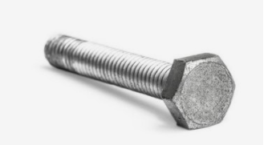
Three days after school got out, The Trip was finally here. Everything was packed and ready to go. Mom said that we were supposed to leave at 9 a.m. But when dad noticed a wet spot under the van, I realized we wouldn't be going anywhere for a while. Dad crawled under the van. Car parts sprang up around the van like mushrooms.
Minutes turned into hours. By the time Dad gave Mom the news, it was late afternoon. “I fixed the leak.” said Dad, “ But now I can't find one of the the fan bolts(螺栓).” Mom organized a search, but in vain.
to appear suddenly or quickly

Slide 5


Reading for the plots
Feelings?
sniggering
After dad fixed the leak, he couldn't find the fan bolts.
unhappy, sniggering
Everything was packed and ready to go, but dad found the old van was leaking.
Climax
No store has the bolts that can fit the old van.
Falling action
Rising action
unhappy
Background
My parents planned to drive an old van across the USA for 58 days this summer, but I was unwilling.
Settlement

Slide 6
Read for the plots:
Paragraph 1: Dad called the stores but none carried the bolt
that fitted this old van._______________________________
Paragraph 2: Then it hit me. “Max!” I shouted, “Find Max!”
__________________________________________________
Q1: How would my parents feel? (especially dad)
Q2：How would I feel at this moment?
Q3: How to solve the problem?
Why did the author ask to find Max?
sniggering & sorry
hit
Q1：What would we do to find Max?
Q2：Will/How we find the bolts?
Q3：How would I feel about the trip at this moment?
relieved/happy/expective
情感的变化过程，事情发展过程，解决问题的过程

Slide 7
Read and rethink:
Find the continuation points
续写点 | 伏笔语言 | 续写时可照应语言
Para 1
Para 2
Para 3
Para 4
第二段首句
But I didn't even want to think about it.
表明我根本不想去旅行。第一段可以
这样照应：
My soul silently rejoiced/ I sniggered.
Fifty-eight days! That was practically my
whole summer! But I knew it was useless
to protest.
父亲一直想要的旅行不能按计划进行，
肯定很伤心。第一段可以这样照应：
His dream—The Trip of a Lifetime—was vanishing before his eyes/His face clouded.
He said that he'd always dreamed of
driving across the country.
Good-bye, summer vacation. Good-bye,
diving at the lake. Good-bye to hanging
out and doing absolutely nothing.
Good-bye, Max. I was going to miss
this ball of fur.
He batted a button across the floor like a
soccer player. He was interested in all
small objects.
我得知旅行无法进行很开心。第一段可以这样照应：My summer vacation will come back/ The thought of diving at the lake and hanging out floated in my mind.
Max喜欢玩纽扣之类的小物件。第一段结尾可以这样照应：Suddenly a buttone came
into my vision. 第二段可以这样照应：Max was playing the bolt with its paws.
Then it hit me. “Max!” I shouted, “Find
Max!”
根据首句可联想到Max拿走了螺栓。第二段可以这样照应：What appeared in its
mouth was just the lost bolt.

Slide 8
problems:
场面铺的太大，无关情节严重影响了主要情节的开展和描写，重点不突出，直接导致低分；
没有把握作者的心理变化，情节和主题偏离
没有良好的衔接
结尾主题升华差强人意

Slide 9
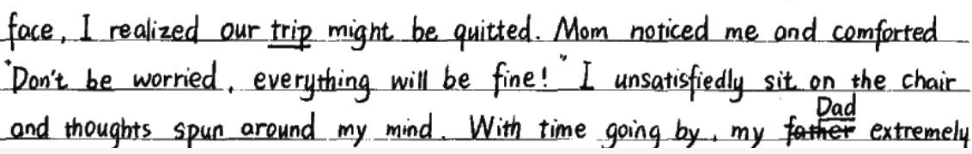
Comment on your essay:
Is the plot reasonable? why?
与原文续写点相违背：
①. But I didn't even want to think about it.
②. It was useless to protest.

Slide 10
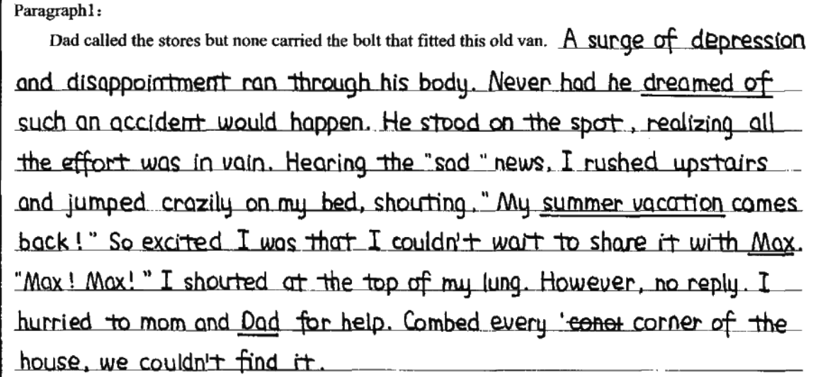
Is the plot reasonable? why?
上文看，作者应该是一个能够从父母的角度去考虑问题的孩子，shouting等词从情感角度不太符合上文人设
与原文结尾相违背：
What my parents were searching for should be the bolt, but not the cat.
与第二段首句衔接不连贯：
Then it hit me. “Max!” I shouted, “Find Max!”

Slide 11
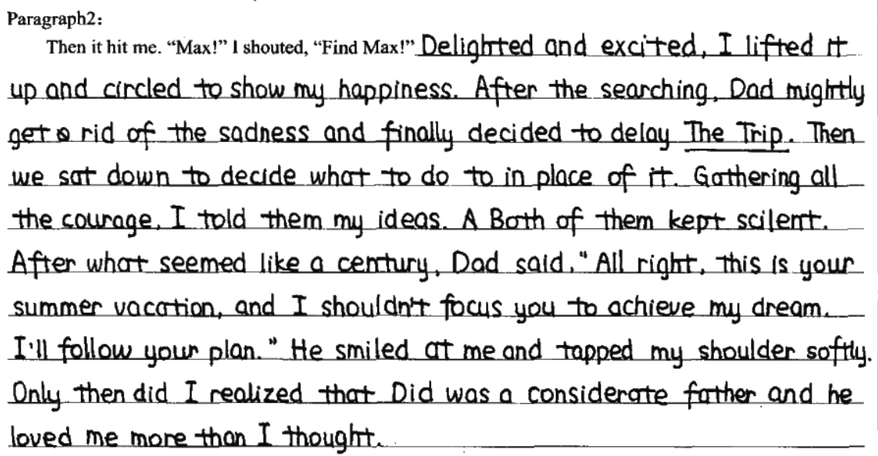
Is the plot reasonable? why?
与文章主题不符：
文章主要讲述了旅行前的一件趣事，以及作者从不乐意到最终接受甚至期待的过程
情感逻辑矛盾，找到猫是为了解决车的问题：

Slide 12
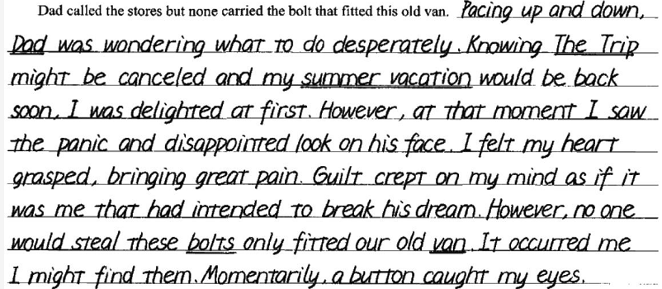
Is the plot reasonable? why?
At this critical moment,
照应原文细节:①. But I didn't even want to think about it. ②. But I knew it was useless to protest.
③. He batted a button across the floor like a soccer player.

Slide 13
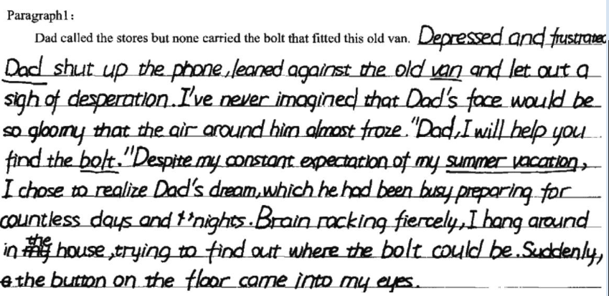
Conclusion：我们可以从以下角度挖掘续写点：
1. 原文首段：故事背景
①. But I didn't even want to think about it.
2. 关注特定情节：对续写部分有推动或暗示作用
的情节
Good-bye, Max. I was going to miss this ball of fur. I put him down and laughed as he batted a button across the floor like a soccer player. He was interested in all small objects.

Slide 14
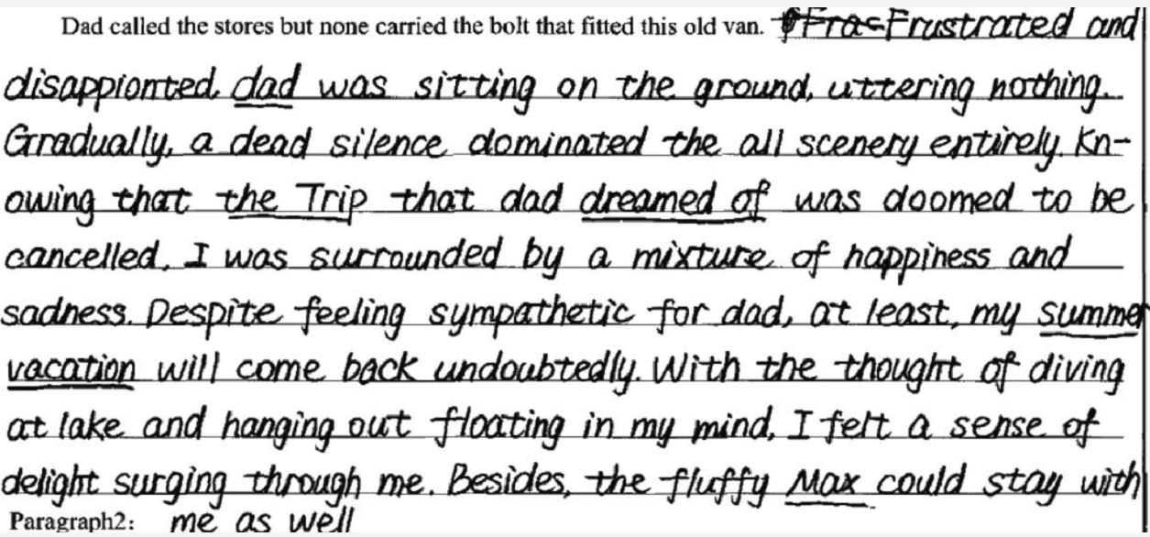
3.留意细节描写：语言描写、动作描写、神态描写、外貌描写、心理描写、环境描写和情感变化描写；
Good-bye, summer vacation. Good-bye, diving at the lake. Good-bye to hanging out and doing absolutely nothing. Good-bye, Max. I was going to miss this ball of fur.

Slide 15
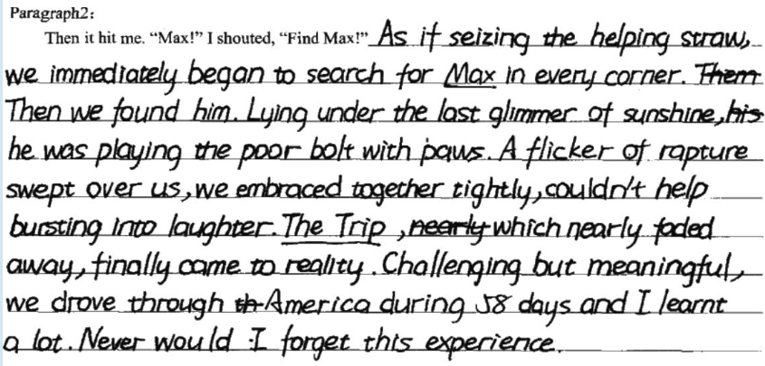
4.解读续写所给首句：第二段的开头往往隐含了第一段结尾所包含的信息。
Paragraph 2: The it hit me. “Max!” I shouted, “Find Max!”

Slide 16
Appreciation:
Dad called the stores but none carried the bolt that fitted this old van. I gasped. Maybe we were not going on The Trip after all. According to Mom, messing up our agenda(日程表)—even by one day— would send our schedule toppling(颠倒) like dominoes(多米诺骨牌). Reservations would need to be canceled; destinations would be changed. My soul silently rejoiced(深感欣喜). But then I saw Dad. He was leaning over the engine, his hands black with grease(润滑油). His dream—The Trip of a Lifetime—was vanishing before his eyes. “So much for seeing everything from ‘sea to shining sea,’” Dad said with a weak smile. Earlier, I would have celebrated. But not this moment. I couldn’t bear to see Dad so disappointed. I stared at the lifeless van—the reason that his dream was fading. I wondered where that bolt could be.

Slide 17
Then it hit me. “Max!” I shouted, “Find Max!” Without knowing why, everyone scrambled(仓促行动) to look for the cat. I found him at the end of the driveway near the garage. As usual, he was batting something around. I scooped up Max, and sure enough, there was the bolt. I grabbed it and waved it like a flag. Dad’s face lit up. An hour later, I was in the van with my family. Dad glanced back at me in the rear-view mirror. “Thanks!” he said. I smiled. As our van chugged((发动机缓慢运转时)发出突突声) down the freeway, I thought this trip might not be so bad after all. Good-bye, regular old summer vacation. Hello…Trip of a Lifetime?

Slide 18
scramble: 1)to move quickly, especially with difficulty, using your hands to help you （迅速而吃力地）爬，攀登
She managed to scramble over the wall. 她好不容易翻过墙。
He scrambled to his feet as we came in. 我们进来时，他慌忙站起身。
2.(for sth) to push, fight or compete with others in order to get or to reach sth 争抢；抢占；争夺
The audience scrambled for the exits. 观众竞相朝出口拥去。
Shoppers were scrambling to get the best bargains. 顾客争先恐后地抢购最便宜的特价商品。

Slide 19
She scooped the child up in her arms. 她一把抱起孩子。
The train chugs down the track.
火车沿着轨道嘎嚓嘎嚓地缓慢行驶着。
The boat chugged down the river. 小船突突地沿江而下

Slide 20
Dad called the stores but none carried the bolt that fitted this old van. He tried starting the car without the bolt. No miracle. Gears rattled, the engine roared and a choking gust of coal black smoke flooded from its pipes, swallowing all three of us. I had to confess that moment, a slight touch of relief came creeping on my mind. Out of an impulse of curiosity, I glimpsed at dad one time or two. His head ducking, his gaze rested steadily on the rusty van, beads of sweat swelling upon his forehead. I could see clearly the light in his eyes had fainted. A mixed feeling of restlessness and sourness clung(cling) upon my heart, "Where is the bolt on earth?" A desiring voice lingered from my inner side.

Slide 21
Dad called the stores but none carried the bolt that fitted this old van. He tried starting the car without the bolt. No miracle. Gears rattled（齿轮发出嘎嘎声）, the engine roared and a choking gust of coal black smoke flooded from its pipes, swallowing all three of us. I had to confess that moment, a slight touch of relief came creeping on my mind. Out of an impulse of curiosity, I glimpsed at dad one time or two. His head ducking, his gaze rested steadily on the rusty（生锈的） van, beads of sweat swelling upon his forehead. I could see clearly the light in his eyes had fainted. A mixed feeling of restlessness and sourness clung(cling) on my heart, "Where is the bolt on earth?" A desiring voice lingered from my inner side.

Slide 22
Then it hit me. "Max!" I shouted, "Find Max!" "Yeah, Max..." Dad sprang to his feet, murmuring to himself with shivering lips. We cast glances all around the house. Never in my wildest dream had I dreamed that Max would be so smart and naughty. We searched every corner of every room but Max was nowhere to be found. It was when we were about to give up that a ripple of mews(喵喵叫） stirred up our nerves. "Aha, got it!" Dad paced cautiously toward the van, stretched out his arm and reached for the handle. The door was slammed open and Max, full of elegance, was leaning against the back of the seat, and licking the bolt. The leak was fixed and soon we were on the trip of lifetime in delight as expected.

Slide 23
Then it hit me. "Max!" I shouted, "Find Max!" "Yeah, Max..." Dad sprang to his feet, murmuring to himself with shivering lips. We cast glances all around the house. Never in my wildest dream had I dreamed that Max would be so smart and naughty. We searched every corner of every room but Max was nowhere to be found. It was when we were about to give up that a ripple of mews(喵喵叫） stirred up our nerves. "Aha, got it!" Dad paced cautiously toward the van, stretched out his arm and reached for the handle. The door was slammed open and Max, full of elegance, was leaning against the back of the seat, and licking the bolt. The leak was fixed and soon we were on the trip of lifetime in delight as expected.？

Slide 24
They clung together, shivering with cold. 他们紧紧地抱在一起，冷得直发抖。
cling (on) to sb/sth 1)hold on tightly to sb/sth 抓紧；紧握；紧抱
Survivors clung to a raft. 幸存者们紧紧抓住救生筏
She clung on to her baby. 她紧紧抱住她的婴儿。
2) to stick to sth 粘住；附着
The wet shirt clung to his chest. 湿衬衫紧贴在他的胸部。
The smell of smoke still clung to her clothes. 烟味仍附着在她的衣服上不散

